Slide 1


architecture_overview.png
HSM Operation
Business Application
Server Operation
Log-Collector
Crypto Provider
Monitoring
Partition PW
Service PW
Securosys
Customer
Securosys
Operations
Partner
Firewall
Firewall
Reverse Proxy
Reverse Proxy
Authentication
/ Dir Service
HSM
HSM
Authentication
/ Dir Service
sync
Log-Relay
HSM
HSM
Log-Relay
Auxiliaries
Auxiliaries
CloudHSM - Datacenter A
CloudHSM - Datacenter B
Firewall/VPN/Aux
Legend
HSM
Network Gateway
Auxiliary Server
CloudHSM - Backup Datacenter C

Slide 2
communication.png
Business App
Crypto-Provider
1
3
7
CloudHSM
Firewall
2
6
4
Proxy
LDAP
5
8
Primus HSM

Slide 3
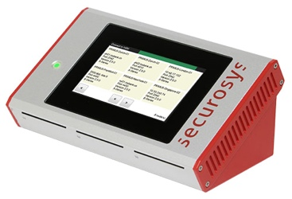

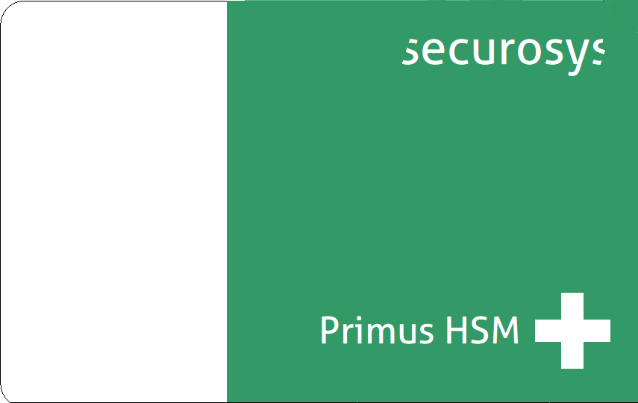


system_overview.png
Customer
Partition Admin
Business Application
Partition Access
JCE / PKCS#11 / MSCNG
REST
Securosys
TSB / REST API
HSM
HSM
Active
Datacenter(s)
sync
HSM
DR
Datacenter

Slide 4
service_user.png & technical_user.png
E-Mail
Link to
Download Portal
Access
Download Portal
Download Credentials
SMS
Security Code

Slide 5



global_cluster.png
Customer
Site A
Customer
Site B
Customer
Site C
Priority:
URL US
URL SG
URL DE
Priority:
URL DE
URL US
URL SG
Priority:
URL SG
URL US
URL DE
Sync
Sync
US
DE
SG
CH (DR)

